Slide 1
Social Robotics
Presented by: Shim Vui Ann
12 March 2015

Slide 2
Outline
Introduction
Social Robotics in I2R
Core components: mapping and navigation
Robot development
- Cognitive robot
- Robot mapping and navigation
- Vision guided robot
Conclusion

Slide 3
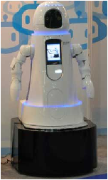


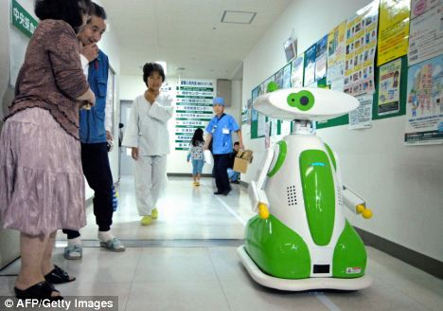
What is social robot?
Have a physical embodiment
Autonomous
Interact with humans
Understanding of social beings
Notes:
Note: The robot is in Aizu Chuo Hospital in Fukushima made by Tmsuk Co. Ltd

Slide 4
Robot Development Trends
Personal Service Robots
Comprehension & Safety
Professional Service Robots
Adaptability
Military robots
Mobility
Ultimate Goal!
Industrial robots
Planning & Control

Slide 5

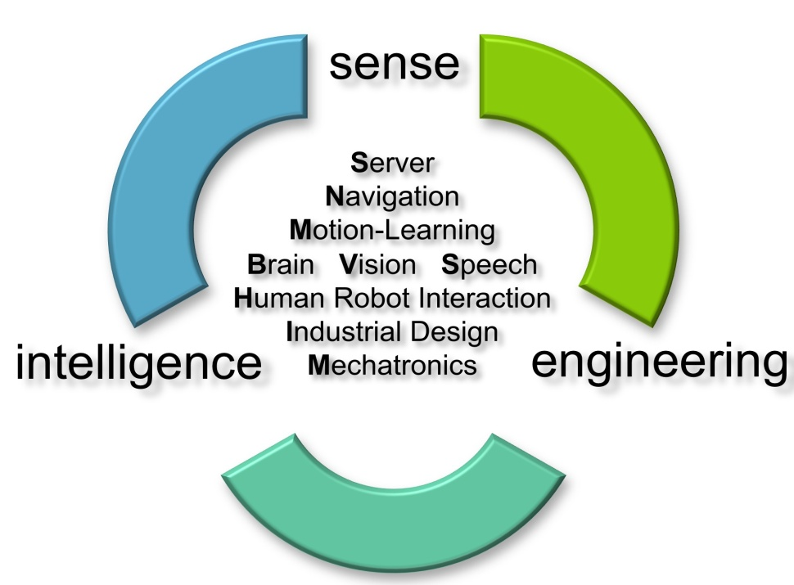
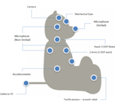
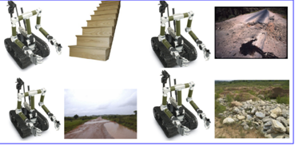
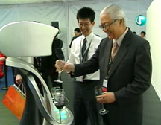


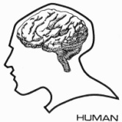
Social and Service Robotics
Robotic Attention
Sound localization
Robotic audition & vision
Human-robot dialogue
Robotic operating system (Brain)
Cognitive learning
OLIVIA 2.0
MIKA
Robotic
Cognition

Slide 6
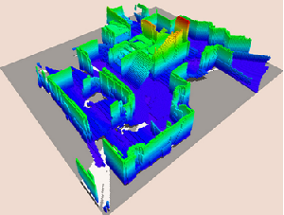
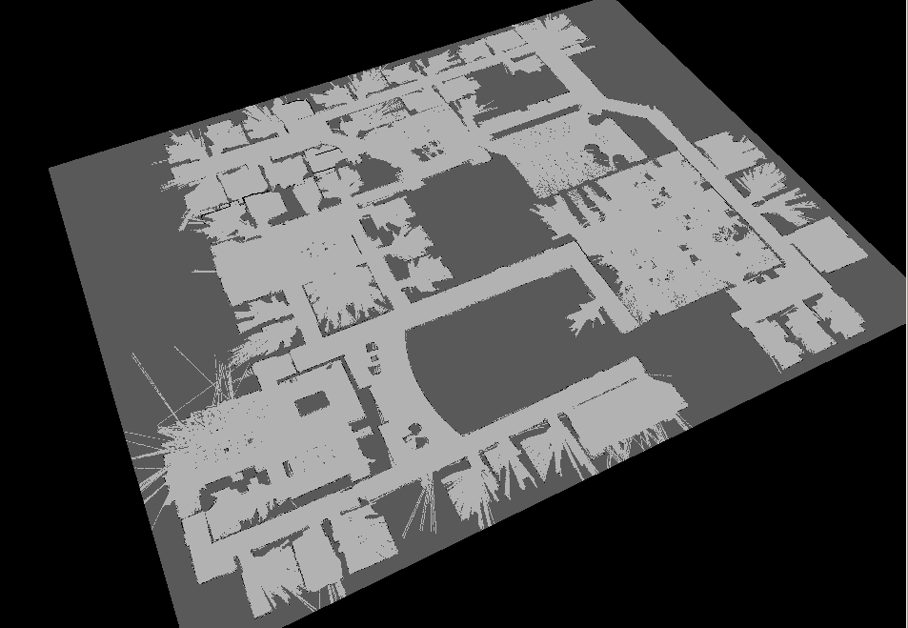
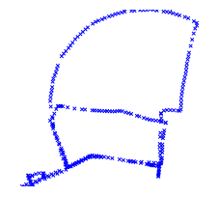
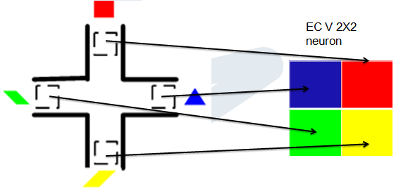
Mapping
Occupancy-based SLAM
- Features: very detail information of the physical environment is required to construct the ground-truth map, accurate representation
Appearance-based SLAM
- Features: Only record partial information of the environment to construct topological map
Neuronal Activities
- Features: Spatial information - in neuronal activities

Slide 7

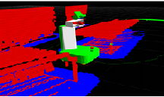
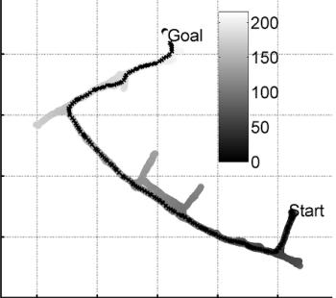
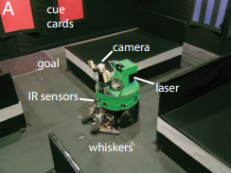
Navigation
Voxel-based 3D mapping (Eitan et al. 2010)
- Map: Used occupancy grid to build costmap
- Cons: Detailed environmental data is required, slow
RatSLAM (Milford and Wyeth 2009)
- Map: Topological’s cognitive map
- Cons: Need to follow closely the global path
Darwin XI (Fleischer et al. 2007)
- Map: Location as neuronal activities
- Global planner: No.
- Cons: Small area

Slide 8
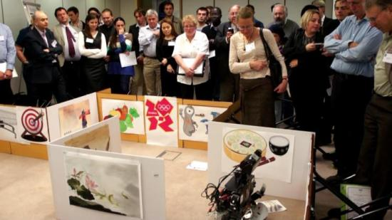
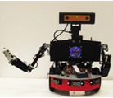
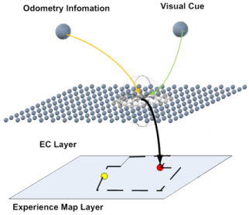
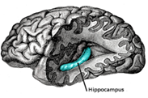
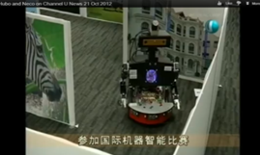
Neural Cognitive Robot (NECO)
Robot Platform
+
Peripheral Algorithms
Sensors
Actuators
Manipulation
Communication
The robot is able to navigate in very complex unknown environments through active cognition.
+
Brain Based Model
Discovery of navigational cells in brain
Applicable Computational Model based on brain structure and function

Slide 9
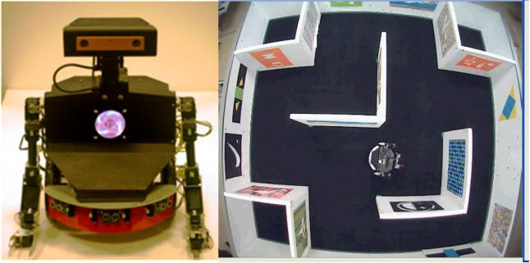
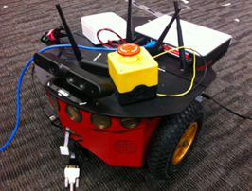
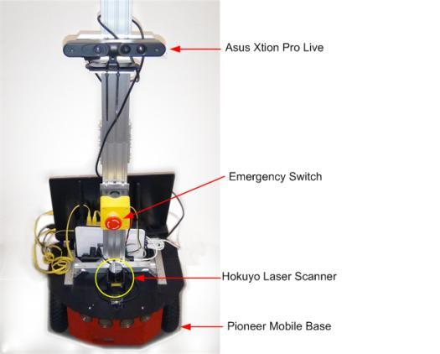
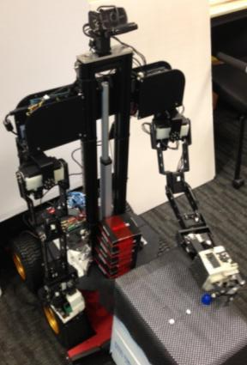
NECO Series
NECO I and the maze environment
NECO II, preliminary setup
NECO III, in development
NECO II, current setup

Slide 10
Research Map
Neuro-Cognitive Systems
capable of learning and adaptation
Micro-level:
Neural Circuits
Macro-level:
Intelligence
Memory Coding
Neco
NEural COgnitive Robot
Associative
Memory
Episodic
Memory
Brain Based Model
Synaptic Learning
Neural Coding
Notes:
Research map of our group. But today I am going to introduce Neco only.

Slide 11
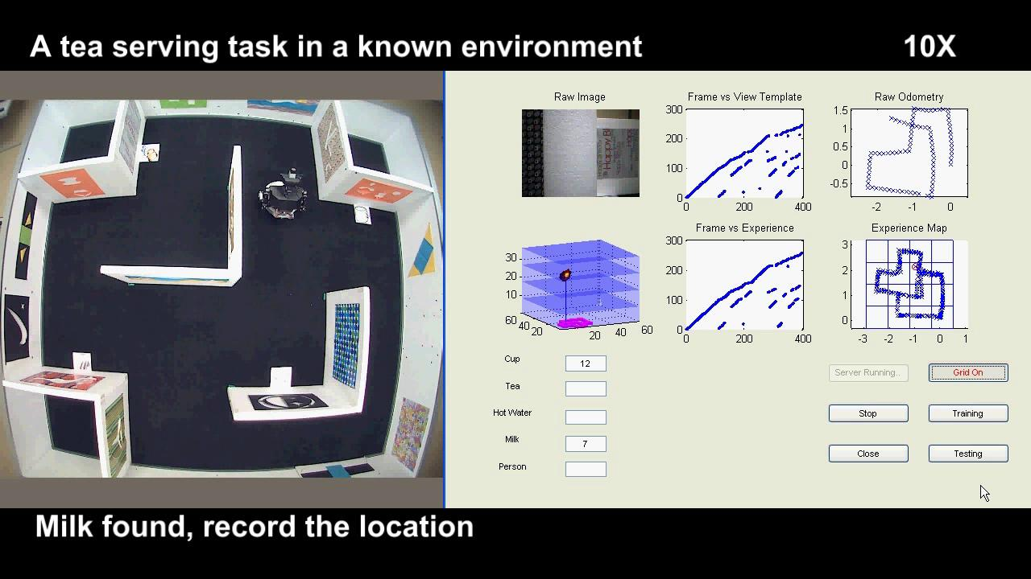
Video: Cognitive mapping in maze

Slide 12
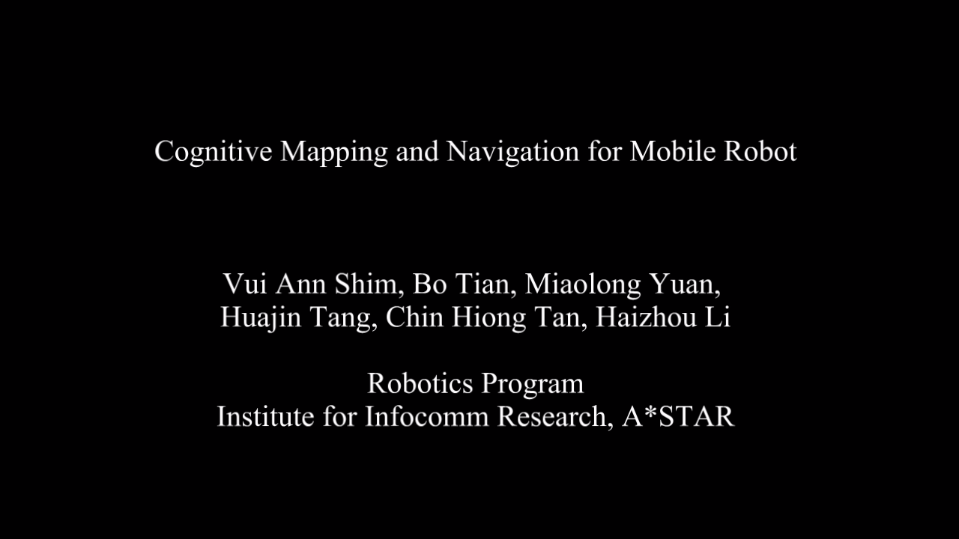
Video: Cognitive mapping in office

Slide 13
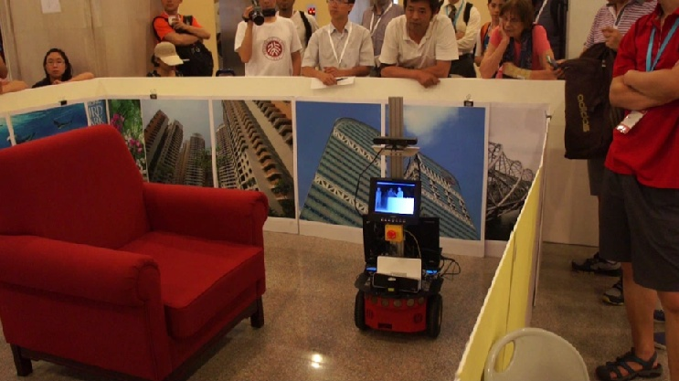
Video: Gesture recognition

Slide 14
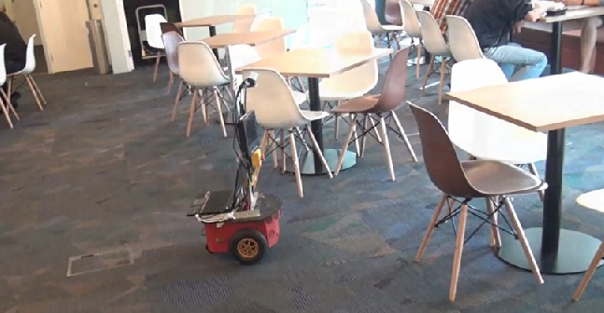
Video: Automatic object searching

Slide 15
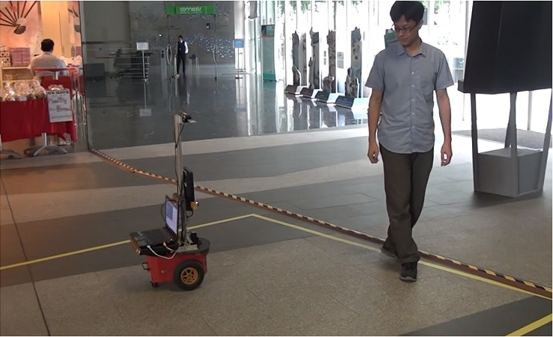
Video: Following people

Slide 16
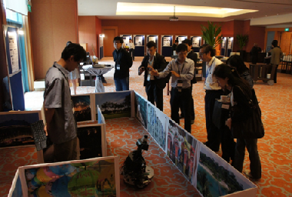
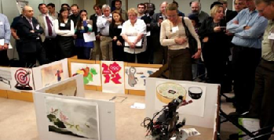
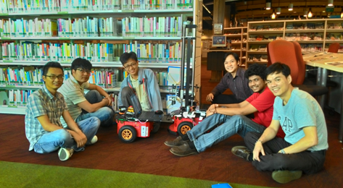
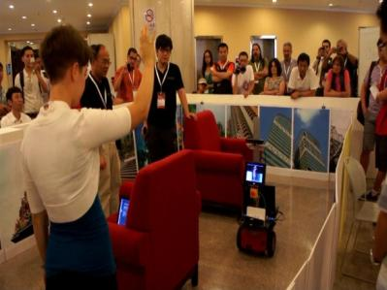
Outside the lab
@ London
@ Sentosa
@ Serangoon Library
@ Beijing

Slide 17
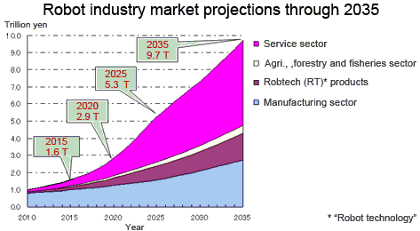
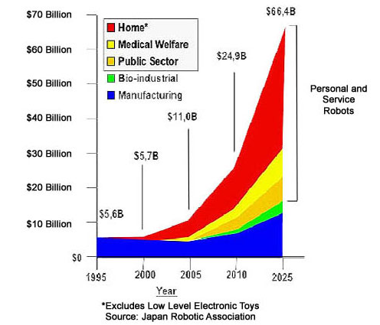
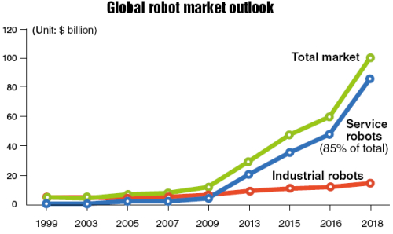
Conclusion
Notes:
The Ministry of Economy, Trade and Industry (METI) and the New Energy and Industrial Technology Development Organization (NEDO) japan
http://www.roboticsbusinessreview.com/article/webcast_investing_in_robotics_for_20151

Slide 18
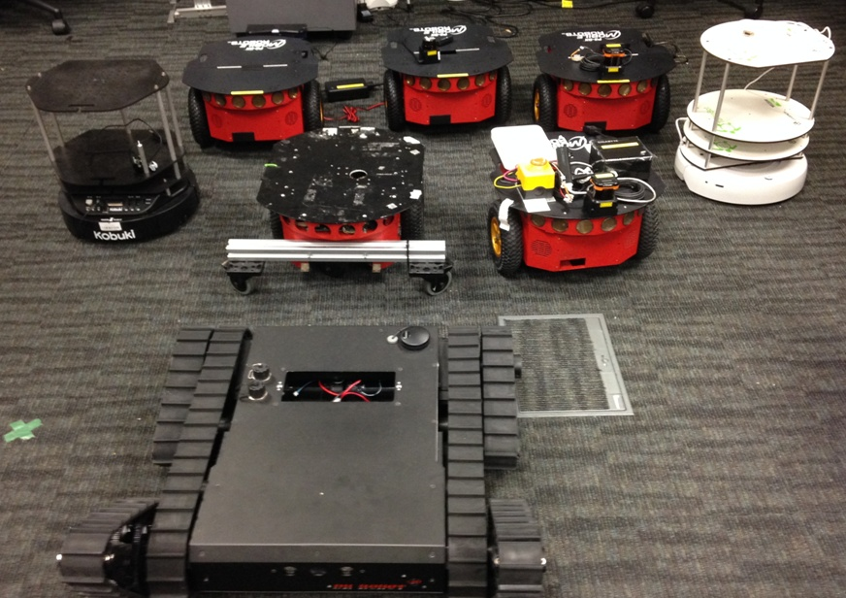
Future
Notes:
The Ministry of Economy, Trade and Industry (METI) and the New Energy and Industrial Technology Development Organization (NEDO) japan
http://www.roboticsbusinessreview.com/article/webcast_investing_in_robotics_for_20151

Slide 19
Thank You

